Slide 1
Mountains of the Moon university
Faculty of Science, Technology and innovation
Department of Computer Science
BIT 1201: INFORMATION MANAGEMENT
Data collection

Slide 2
Data collection Overview
Data collection is the process of gathering data for use in business decision-making, strategic planning, research, and other purposes.
We can only manage collected facts. In systems, the gathering of data is referred to as requirements determination and involves the use of;
Fact-finding techniques i.e.
  Interviewing
  Questionnaires
  Observation
  Documentation review
  Sampling

Slide 3
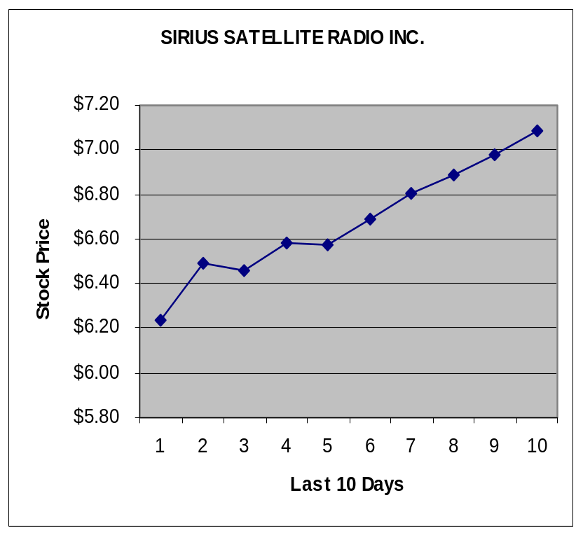
The difference between information and data
Data
6.34
6.45
6.39
6.62
6.57
6.64
6.71
6.82
7.12
7.06
Information

Slide 4
Gathering Information
Need to have a checklist of types of information /
documentation to gather.
Challenges are :
Where to look for information
When to stop looking for information
i.e. how much is enough.

Slide 5
Categories of Information
Information about the Organization
Information about the People
Information about the Work
Information about the Work Environment

Slide 6
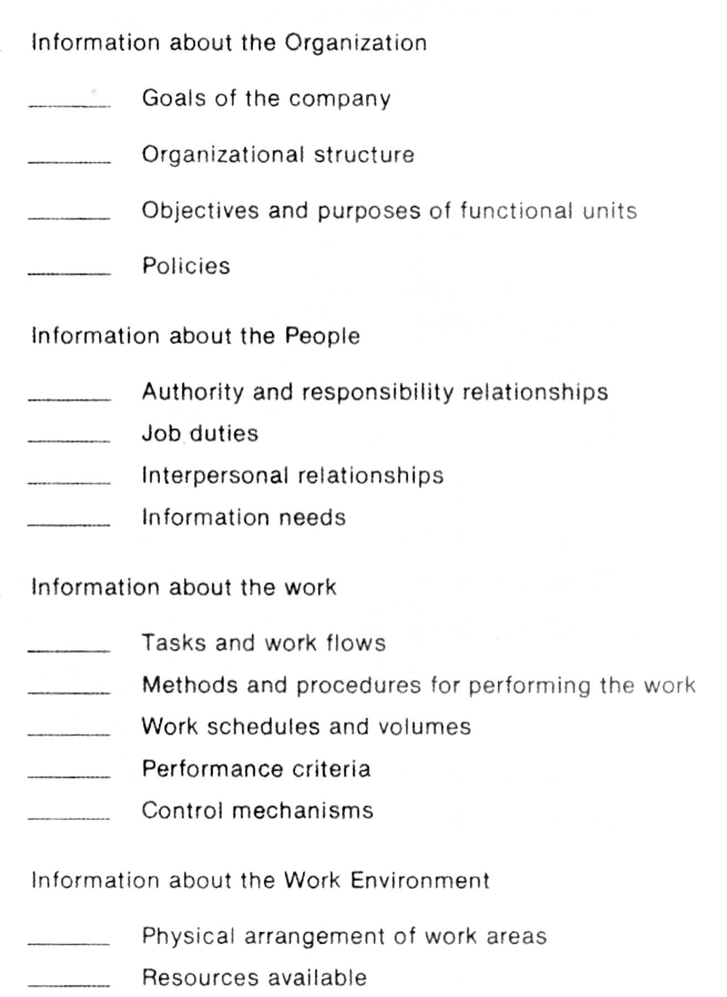
Categories of information checklist

Slide 7
Categories of information checklist

Slide 8
Sources of Information
Existing documentation includes:
  Organization charts
  Methods and procedures manuals
  Job descriptions
  Forms and reports
  Paper / document flow diagrams

Slide 9
Sources of Information (cont)
  Policy manuals
  Computer program documentation
  Data dictionary listing
  Computer operation manuals
  External sources (other companies &vendors)
  users

Slide 10
Methods for gathering Information
  Interviews
  Questionnaires
  Observation
  Documentation review

Slide 11
I) Interviews
Interview
Is a planned meeting during which you
obtain information from users of the existing system.
Interact with users with a specific
purpose in mind.

Slide 12
Types of Interviews
Structured Interview. A structured interview is typically formal and organized and may include several interviewers, commonly referred to as a panel interview. ...
Unstructured Interview. ...
Stress Interview. ...
Behavioral Interview. ...
Problem Solving or Case Interview. ...
Phone Interview

Slide 13
Planning for the interview
Try to answer the following questions
  What do you wish to achieve from the
  interview?
  How will these interviews be conducted?
  What topics are to be covered in the interview?
  Where will the interview take place?

Slide 14

Planning for the interview (cont)
Obtain approval from senior management
Plan who needs to be interviewed (refer to the organization chart).
First interview top managers, then operational personnel etc.

Slide 15
Planning for the interview- General
Prepare for the interview
write down the objective for the interview
write some questions - prepare to investigate further
Make an appointment

Slide 16
Planning for the interview (cont)
Prepare for the interview.
  Make an appointment.
  Place a reminder call.
  Send a memo to organizational managers
  Create a list of questions
  Use a variety of questions
    Open-ended questions
    Closed-ended questions
  Send confirmation memo to the person to be interviewed

Slide 17
Structure of a fact finding interview
It should have/be
  A social chart (talk) – put the person being interviewed at ease
  Overview – an outline of areas to cover
  Questions and answers
    well structured with a four step questioning model having; questions, problem, implications and requirement.
  Closing.

Slide 18
Conducting the interview
Preferably interview one-to-one
Listening tactics - encourage interviewee to talk.
Interviewer comments should be non-
committal e.g. office politics
Minimal note taking
Record if you can

Slide 19
Conducting the interview
Avoid leading questions
Write up interview notes immediately after the interview
As courtesy, send written gratitude remarks for interview conducted accompanied by your interview summary.

Slide 20
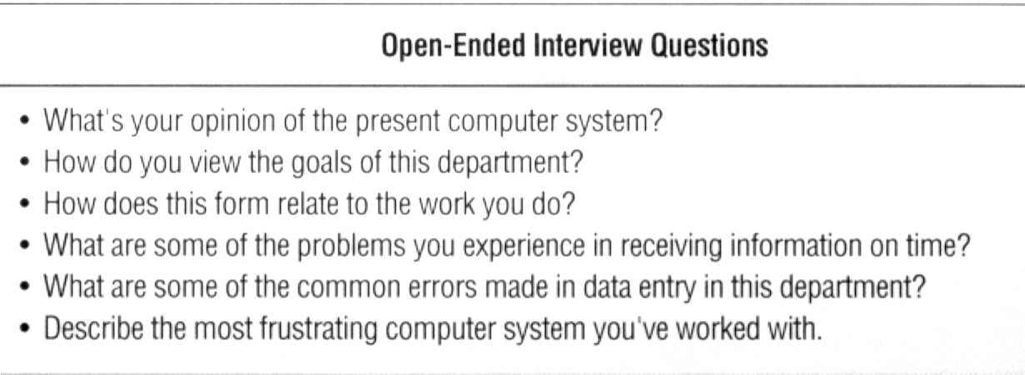
Interviews Questions
Open ended interview questions

Slide 21
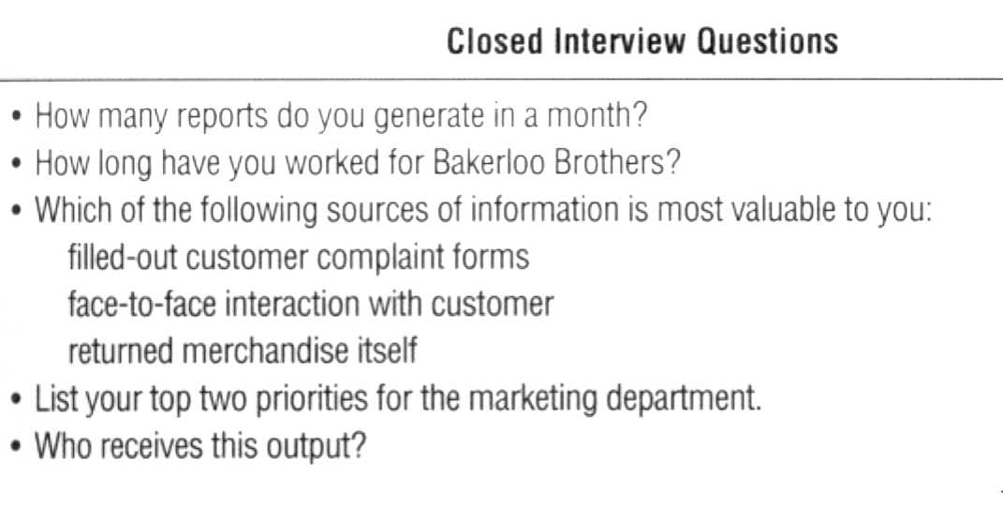
Interviews
Closed interview questions

Slide 22
Open-ended vs. closed questions
Closed ended questions require short answers, no explanations are needed and a responded does not have to write down their opinion on something.
In a closed-ended question, the possible answers can be out in the questionnaire and the respondent ticks the category that best describes the respondents answer. E.g.
  Which course are you pursuing at MMU?
  How old are you?.....
Do you have a business? YES NO
 | BIT |  | CSC |  | BIT |  | DCSIT |  | BSE

Slide 23
Open-ended vs. closed questions
With open ended questions, the possible responses are not given. The respondent writes down the answers in his/her own words. E.g.
  Please explain why you opted for a Bachelors degree in Information Technology?
  What is your opinion on the governments directive to
  charge tax on social media usage (OTT)?
  What changes would you like to see in the registration
  policy of the next academic year?

Slide 24
Interviews
Evaluate the interview
  Identify possible biases
  Determine whether people being interviewed have the necessary experience
  Be able to separate his/her opinion from facts and fiction
Unsuccessful interviews
  Not all interviews are successful
  Find a way to conclude an unsuccessful meeting
  Consider alternatives

Slide 25
Interview-Advantages
Personal contact - face-to-face
Flexible.
The Information Manager can probe for further detail
Best source of qualitative information I.e. opinions of people, policies, and subjective description of activities and problems.
Useful for respondents who do not communicate properly in writing or are lazy to complete questionnaires.

Slide 26
Interview-Disadvantages
Time consuming.
Evaluation of information can be difficult.
Biased by interviewer
Communication / speech problems
Misunderstandings can rise from different user values, or technical jargons by the Information Manager.

Slide 27
Interviews – summary
Determine the people to interview
Establish objectives for the interview
Prepare for the interview
Conduct the interview
Document the interview
Evaluate the interview
Unsuccessful interviews call for alternatives

Slide 28
II) Questionnaires
A questionnaire is a research instrument consisting of a series of questions (or other types of prompts) for the purpose of gathering information from respondents
Request specific information from respondents
  A method for gathering information
  from many people.

Slide 29
Questionnaires design
There are three sections to consider when designing a questionnaire
A heading section
A classification section
A data section

Slide 30
Questionnaires design
Heading section.
  Describes the purpose of the questionnaire & contains the main references - name, staff identification number, date.
A classification section.
  For collecting information that can later be used for analysis and summarizing the total data, such as age, sex, grade, job title, location
A data section.
  Has questions designed to elicit the specific information being sought.

Slide 31
Questionnaires design
Guidelines.
  Should begin with an introduction.
  Bear in mind the level of intellect and the level of interests of the respondents
  Keep questions short, and unbiased, and where possible have multiple answers.
  Avoid too much branching.
  If the survey is extensive, you may consider use of automated means of reading responses.
  Pre-test the questionnaire before using it for purposes of checking whether all the questions will be easily understood.

Slide 32
Questionnaire distribution
Plan on how the questionnaire will be administered; by:
  Mail ?
  Phone?
  Fax ?
  Post ? or
  personal delivery?

Slide 33
Writing questionnaire items
open-ended
fill-in-the-blank
multiple choice
rating scales
ranking scales

Slide 34
Questionnaire – Advantages
Most economical for a large number of people like the entire BIT class
Administered quickly and easily
Results can be analyzed quickly.
Can get reliable information due to anonymity.
Allow collection of data and can be completed at the respondents leisure.

Slide 35
Questionnaire – disadvantages
Effective questionnaires are difficult to construct
Need several drafts and trial mailing
Gathers only limited amount of data
No flexibility to adapt to each respondent to probe more deeply
Misinterpretation of the question.

Slide 36
Questionnaires - summary
Questionnaires
  Brief and user-friendly.
  Clear instructions.
  Questions in logical order.
  Simple wording to avoid misunderstanding
  Avoid leading questions.
  Limit questions raising concern/negative issues.
  Section for general comments.
  Test the questionnaire in advance.

Slide 37
III) Observation
  An Information Manager participates in or watches a person perform activities to learn about the system.
  Often used when validity of data collected through other methods is in question or
  when the complexity of certain aspects of the system prevents a clear explanation by the end users.

Slide 38
Observation
Observation
  Ask questions about present system operation
  Observe all steps in the processing cycle
  Examine each form, record, and report
  Consider each person working with the system

Slide 39
Observation
Observe actual processing associated with the system
Data gathered based on what is seen (not on what people say happens in the system)
Work flow in an office
  follow paperwork from the time a source document is created to when it is filed permanently.

Slide 40
Observation- Advantages
  Permits correction of any misconceptions or erroneous impressions made before.
  Permits verification of statements made in interviews as well as determine if procedures operate as specified in the system documentation.
  You become better acquainted with the operating personnel who will be using the new or changed system.
  Information gathered is “highly believable”

Slide 41
Observation - disadvantages
Performance of people being observed may be affected by the observer’s presence
Trained people needed for observations (not everyone can observe and understand what is taking place- trained observers in that particular field are therefore needed)
  People usually feel uncomfortable when being watched.

Slide 42
IV) Prototyping
Note:
The Prototyping model is also considered a fact
finding technique.
Notes:
What is prototypying
Types of protypes

Slide 43
The Requirements Determination Framework
Requirements determination is the general data-
gathering activity done during analysis.
It has 4 sub activities: -
  Requirements Anticipation
  Requirements Elicitation
  Requirements Assurance
  Requirements Specification

Slide 44
Requirements Determination
Framework cont’d
Requirements Anticipation – the Information Manager imagines that particular requirements are relevant based on his or her previous experience with similar systems and knowledge about the problem domain.
Requirements elicitation – the Information
Manager gathers the essential requirements
from the user employing a variety of techniques,
such as interviews and questionnaires.

Slide 45
Requirements Determination Framework
3. Requirements Assurance – the Information Manager validates and verifies the requirements with the user as being the real and essential requirements.
4. Requirements Specification – the Information Manager explicitly collections and documents the requirements either during or after the elicitation and assurance activities.

